Slide 2
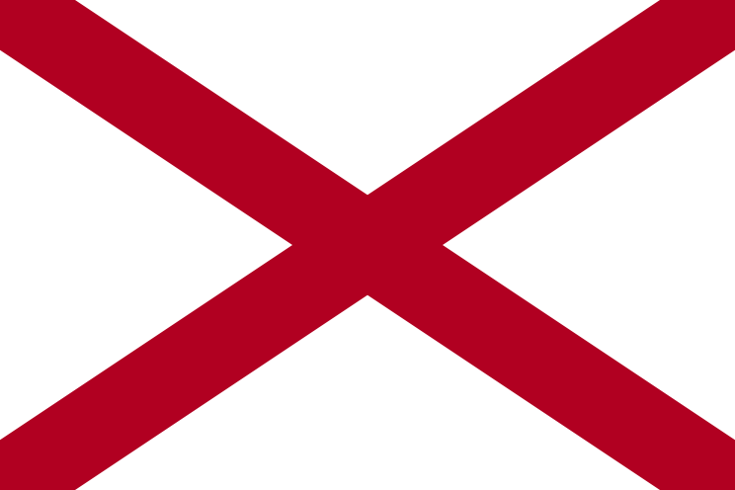
Alabama
There have been some significant ABC activities. They have increased the staff of sworn officers to 125, the highest number in more than a decade and have entered into agreements with local coalitions around the State to conduct more Alcohol Minor Compliance Checks through grants provided by the Alabama Department of Mental Health. Through these efforts they have conducted more than 5,000 Compliance Checks statewide during the last fiscal year resulting in 618 Sales to Minors (a noncompliance rate of 11.97%) and completed more than 14,000 Licensee Inspections, resulting in more than 2,700 Administrative Violation Cases.
With funding from OJJDP, MADD Alabama has provided AlcoholEdu for High School, a Web-based prevention program that engages high school students with science-based alcohol education to combat underage drinking. For this course, MADD Alabama collected data on students’ alcohol-related knowledge, attitudes, and behaviors. The program also provides educators and administrators with reports measuring students’ alcohol-related attitudes and behaviors. Self-report data were obtained from 310 freshmen in Alabama.
SADD Highlights included such as joint MADD/SADD meeting with Robert E. Lee High School in Montgomery, Alabama, press and a joint MADD, and ABI prom training at Booker T Washington High School, in Tuskegee, Alabama.

Slide 3
Alaska
A package of legislation strengthening existing laws concerning alcohol-related crime was signed by Governor Sean Parnell in June 2010. This legislation included an increase in civil damages for purchasing alcohol for minors.
Several media campaigns focusing on underage drinking were developed by and with EUDL coalition members in rural Alaska. These campaigns are being promoted and aired throughout Alaska.
Before graduation in May, Juneau-Douglas High School hosted the national program, Every 15 Minutes, and Students Against Destructive Decisions created public service announcements and assisted in the Safe and Sober Free Prom activities held at the school. Juneau-Douglas has experienced a decline in Minors Consuming Alcohol!

Slide 4
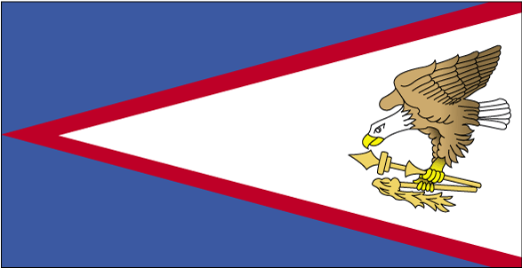
American Samoa
The Territory launched an island-wide, responsible beverage service training.
Outreach to local media outlets has resulted in the media providing more coverage of underage drinking issues, including how to identify false identification, how to be more responsible servers of alcohol, and how everyone can work to make safer communities.
First Lady Mary Ann Taufaasau Tulafono continues to be a strong supporter of underage drinking prevention efforts with the TA’ITA’ITAMA initiative which draw the attention of youth and adults to harms and risks of underage drinking.

Slide 5
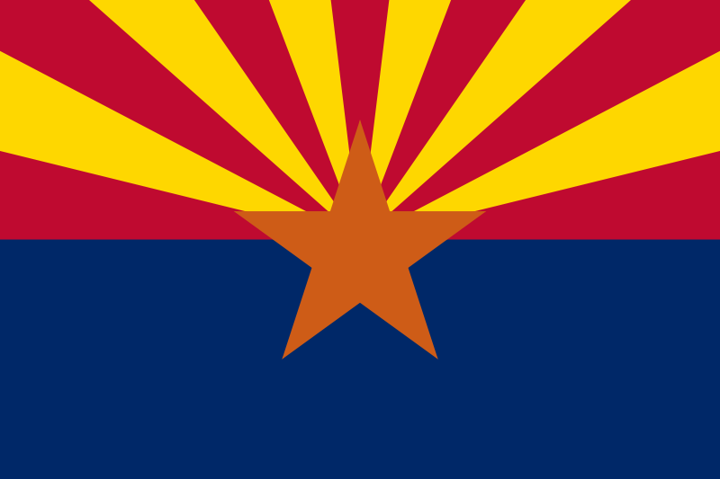
Arizona
The Fake ID 101 Campaign in Tucson resulted in a 75 percent decrease in the number of fake IDs confiscated while the number of patrons through the door increased. The campaign is being expanded to other communities in Arizona throughout 2010.
Military discretionary work in Tucson/Davis-Monthan Air Force Base and Phoenix/Luke Air Force Base successfully concluded in March 2010.
A Volunteer Merchant Keg Tagging Program was launched in Pima County during the summer of 2010, which includes 8 of 13 Tucson liquor merchants and will be an important tool for addressing underage drinking by college students and others.

Slide 6
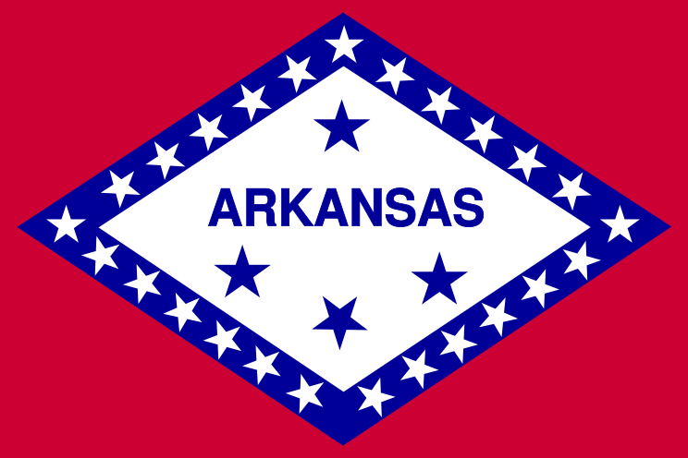
Arkansas
The Arkansas Department of Finance and Administration/Office of Intergovernmental Services has funded activities for elementary to college age students.
Collaborative efforts between law enforcement agencies, universities/schools, community partners and coalitions have produced thriving efforts to enforce underage drinking. The collaborative efforts included shoulder taps, compliance checks, sobriety checkpoints, party patrols/enforcement of social host laws, parking lot surveillances, saturation patrols, fake ID enforcements, impaired driving with focus on youth and community fairs.
Earned media coverage of enforcement activities included numerous articles, interviews, and op-ed pieces.

Slide 7
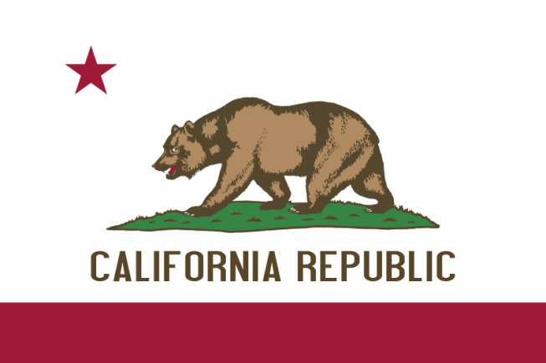
California
Under the Special Event Enforcement Program, the California Alcoholic Beverage Control responded to numerous requests for assistance from local law enforcement agencies. Out of the approximate 165 events worked there were a total of 1,365 arrests made.
In August and September of 2010, the City of Berkeley coordinated operations focusing on “Welcome Back Week” and “Rush Week.” These operations were geared toward underage drinking among University of California, Berkeley students. The operations netted 284 arrests for the 6 days.
The Department produced a 30 second public service announcement (PSA). The PSA highlights the consequences minors face when attempting to illegally buy alcohol.

Slide 8
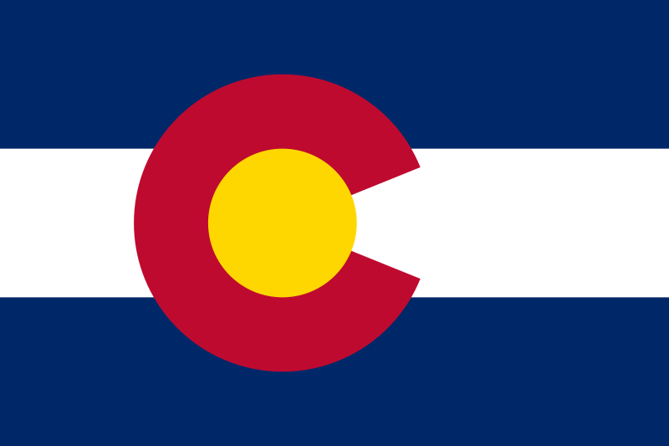
Colorado
The Colorado Liquor Enforcement Division (LED) has conducted over 7500 compliance checks since 2004. Vigorous enforcement, combined with effective retailer education, has resulted in increasing the initial compliance rate of 53% to the current rate of nearly 90%.
LED used grant funds for enforcement activities at major events, such as the State Fair and Mile High Music Festival, doubling the number of criminal charges files for minors in possession, provision to minors, and possession/use of false identification.
LED provided EUDL sub-grants to 52 local law enforcement agencies and community based programs working to reduce underage drinking through prevention and treatment.

Slide 9
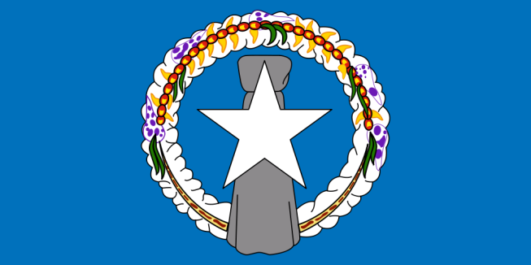
Northern Mariana Islands
In November 2009, the CNMI participated its first on-site training and technical assistance delivery event provided by the Underage Drinking Enforcement Training Center. After the training, CNMI conducted its first ever joint task force compliance check operations. Within three months, the task force made five arrests and cited all establishments caught selling alcohol to minors. The cases have been forwarded for prosecution.
Governor Benigno Repeki Fitial proclaimed April 2010 Enforcing Underage Drinking Law (EUDL) Awareness Month. Activities included EUDL Town Hall Meetings, compliance check operations, a EUDL youth softball tournament, and the first ever CNMI EUDL Youth Conference.
The EUDL Task Force helped to introduce House Bill 17-17 in the Legislature. This bill would increase alcoholic beverage license fees and penalties for any violators caught selling alcohol to minors.

Slide 10
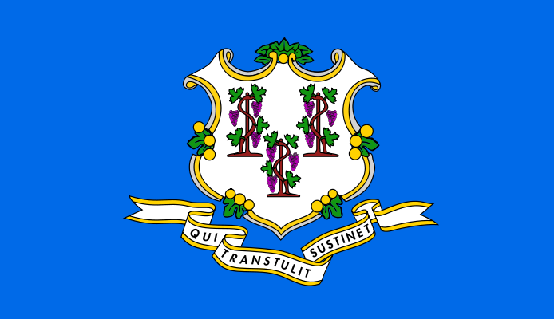
Connecticut
For calendar year 2009, the EUDL funds supported Liquor Control agents and trained minors on compliance check operations at 665 on- and off-premise locations in 30 towns. Of the 665 locations visited, 122 sold to minors resulting in an overall failure rate of 18.35 percent and an overall compliance rate of 81.65 percent. More specifically, the failure rate for on-premise locations was 18.6 percent; for markets and grocery stores, 23.35 percent; and for liquor stores, 13.31 percent.
The Ninth Annual Youth Forum/Showcase of Five Youth Mini Grant Teams was held in June 2010, with 75 youths and 12 adult advisors attending. Special “stations” at the forum included (1) a display and an interactive workshop on graphic effects of alcohol poisoning and alcoholism on liver, lungs, and heart; (2) a nutrition education and physical activity workshop using Wii technology; (3) a poster on “What are YOU doing this summer to keep it Fun, Safe, and Drug Free”; (4) a 3-D mural photo display; (5) a healthy refreshment stand; (6) educational “critical thinking” board games; (7) a Healthy Music and Raffle; (8) an Outdoor Obstacle Course; and (9) a Facebook Group.
Work to strengthen the statewide infrastructure for youth leadership in the prevention of underage drinking with Students Against Destructive Decisions (SADD) resulted in updating SADD contact lists, re-engaging 2 chapters, providing technical assistance to 10 chapters, conducting 2 regional SADD meetings, and conducting an annual SADD conference.

Slide 11
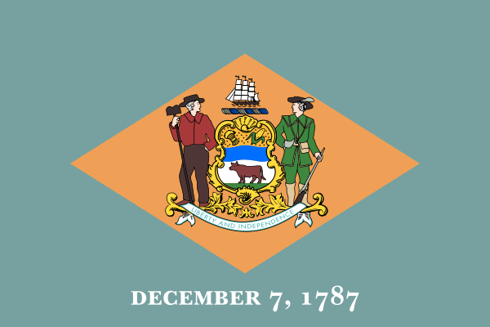
Delaware
This year the Delaware Office of Highway Safety (OHS; EUDL administration) for the first time funded underage alcohol enforcement by the University of Delaware campus police. In 77 hours of enforcement over 3 months, the campus police netted 14 youth for alcohol violations and referred 21 minors to University sanctions, which are tougher than the legal penalties.
OHS also partnered with an American Legion Post 25 baseball team. The coach conducts presentations to his team before each practice on the dangers of underage drinking and impaired driving, tying it back to athletics.
OHS provided funding to eight high schools after prom committees in May. This provided a safe alcohol-free environment for more than 2,000 students.
OHS used a new mapping and data tool to identify a hot spot for underage alcohol crashes and partnered with the town’s police force for the first time. One month of enforcement netted eight arrests. The data tool is helping OHS plan effectively and early results show a 9 percent drop in youth alcohol-related arrests statewide.

Slide 12
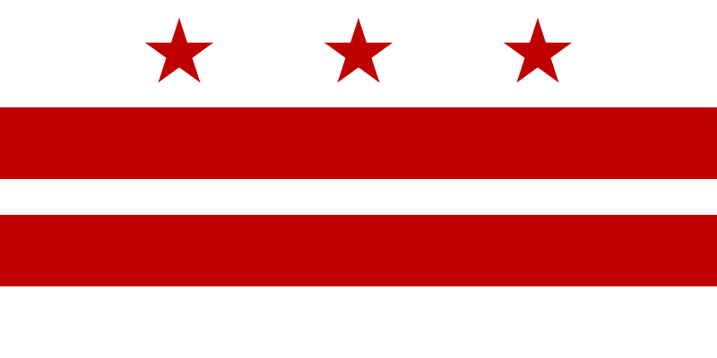
District of Columbia
The DC Double Check 101 program involves a joint partnership created by ABRA, NCCPUD, and MPD along with the full support and cooperation of eight colleges and universities in the District of Columbia (DC). The program was formed to address UAD in the district related specifically to college students (i.e., fake IDs and retailers serving alcohol to minors). Information received through the program is used for education, training, and enforcement efforts. Another significant program objective is increased/improved relationships with the community, the schools, and the enforcement agencies.
ABRA, MPD, and NCCPUD conducted 227 underage compliance checks of off-premise ABC establishments: 42 establishments sold alcoholic beverages to minors, and 184 establishments were in compliance. ABRA and NCCPUD also conducted 467 underage compliance checks of on-premise ABC licensed establishments: 49 establishments sold alcoholic beverages to minors, and 418 establishments were in compliance. In addition, one on-premise establishment served a minor. ABRA, NCCPUD, and MPD conducted the underage drinking compliance checks. NCCPUD provided 47 youths to participate in the underage drinking compliance checks, which were conducted based on the availability of the youths.
DC Prevention Network has a Memorandum of Understanding between the Department of Health Addiction Prevention and Recovery Administration (APRA) and JGA; EUDL subgrantees and four DC Prevention Centers are members. This Network has resulted in monthly meetings, an initial Community Conversations Town Hall Meeting with results, and continuation of Community Conversations coordinated by the DC Prevention Centers. The purpose of the initial Community Conversation Town Hall meeting was to have a cross-section of DC youth ask questions of adults involved in underage drinking decisionmaking roles about current policies, programs, and funding and then make recommendations. The facilitator was a 19-year-old man, and the attendees were high school students. Panel members consisted of current EUDL subgrantees and DC’s Youth Mayor.

Slide 13
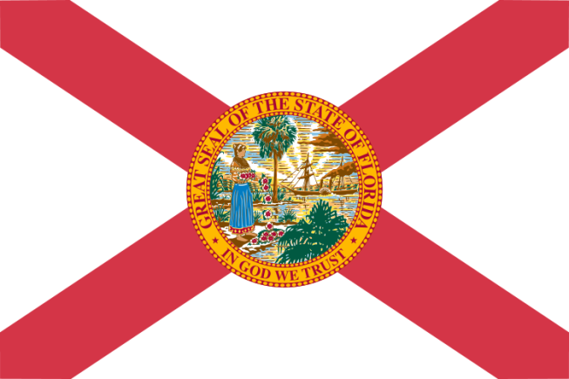
Florida
Forty-four Florida communities, including the Seminole Nation, are using the State’s social marketing campaign for parents called “Be the Wall.”
Fifteen communities have worked successfully for local ordinance changes, such as requiring seller/server training when establishments stay open beyond midnight and limits on who can enter establishments that meet the criteria (i.e., repeated selling to minors, frequent calls for law enforcement assistance) for being a “nuisance.”
Broward County United Way Commission on Substance Abuse worked with a planning team to develop “Promoting Retailers Education Program in Florida” (PREP), a responsible, prevention-oriented beverage seller/server training that includes a training of trainers so that local communities can get their own law enforcement or coalition membership trained to teach the curriculum and maximize the number of people who are trained.

Slide 14
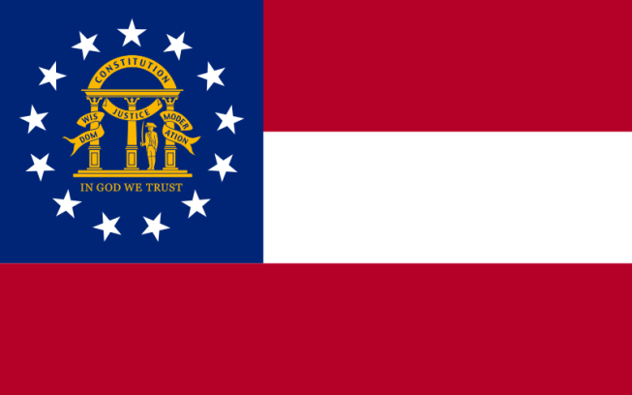
Georgia
The Georgia Department of Revenue’s Underage Alcohol Investigative Group completed another year of excellent work conducting compliance checks in all of Georgia’s 159 counties.
The Council on Alcohol and Drugs (CAD) has completed a media campaign consisting of a documentary and several video vignettes on underage drinking that aired in five major television markets. It was also “picked up” by television stations in Arkansas, Michigan, New York, Pennsylvania, Texas, and Wisconsin. A website hosted the videos for broader exposure, and Georgia schools received related curriculum materials to assist in presenting the videos to classes.
CAD begun work on a radio and print media campaign in the four counties found to be most out of compliance with MLDA 21 sales laws. This campaign will provide support for the Underage Alcohol Investigative Group as it revisits these counties to perform further compliance checks.

Slide 15
Guam
On July 8, 2010, the legal drinking age was raised from age 18 to age 21.
“One Nation” Social Marketing Campaign launched on March 31, 2010, in partnership with the PEACE Office (Department of Mental Health & Substance Abuse). Our short-term goal is to capture the essence of our island culture featuring local people that embrace our cultural values of family, respect, and identity and who live a healthy and alcohol-free lifestyle that could be a model for others. Our long-term goal is to extend the “One Nation” campaign to the outer islands as a Pacific Island campaign seeking pledges to live healthy and alcohol-free lifestyles.
For the first time, with EUDL’s sponsorship of the “One Nation” campaign, the annual Liberation Day Carnival designated ALCOHOL-FREE ZONES throughout the carnival grounds. This carnival took place for 40 nights. Also, during the Liberation Day parade on July 21, the “One Nation” campaign got 29 families to pledge to be alcohol-free during the parade festivities. They were provided with “One Nation” family packs, including a banner with their family name on it saying they are alcohol-free, t-shirts, slippers, a cooler and water, plus many more incentives. “One Nation” was a proud Platinum Sponsor of the 66th Liberation festivities!
Guam EUDL connected with faith-based groups by sponsoring the first annual “In Celebration of Families” carnival on April 10, 2010. The carnival was aimed at building stronger and healthier families by providing them with awareness and education on alcohol laws, the effects of alcoholism, and the consequences of underage drinking. This event was open to the public and was coordinated in partnership with the Archdiocese of Agana and various village parishes, schools, and organizations.

Slide 16
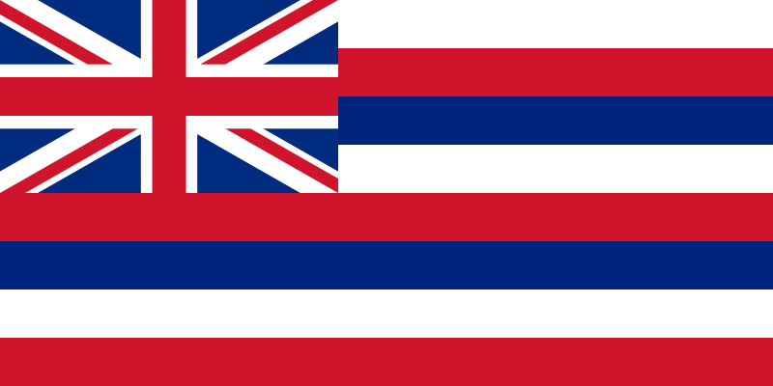
Hawaii
The memorandum for all military members assigned to Hickam Air Force Base, including those assigned to tenant organizations on “Consumption of Alcohol by Individuals Under the Age of 21,” was signed by Colonel Giovanni K. Tuck, Commander, on December 18, 2009. Effective on Dec. 18, 2009, any active duty personnel younger than age 21 who unlawfully consume alcohol or any active duty personnel who provide alcohol to anyone younger than age 21 will have their privately owned vehicle (POV) on-base driving privileges suspended for 6 months. For a second offense, POV privileges will be suspended for 1 year. Those who violate the suspension will have their POVs suspended for 2 years. Active duty personnel younger than age 21 who operate or are physically in control of a vehicle and have a BAC of 0.02 will be suspended for 1 year. If the active personnel moves while on suspension, the gaining installation commander is authorized to honor the suspension.
The local More Than You Think (MTYT) campaign earned the 2010 Communicator Awards from the International Academy of the Visual Arts. Launched in the summer of 2009, the MTYT campaign is all about letting Hawaii’s youth make positive decisions. Research shows that Hawaiian teens think that most of their peers are drinkers, when the truth is, most are not.
Hawaii’s statewide compliance rates resulted in a 9 percent improvement, from 77 percent compliance in 2008 to 86 percent compliance in 2009.

Slide 17
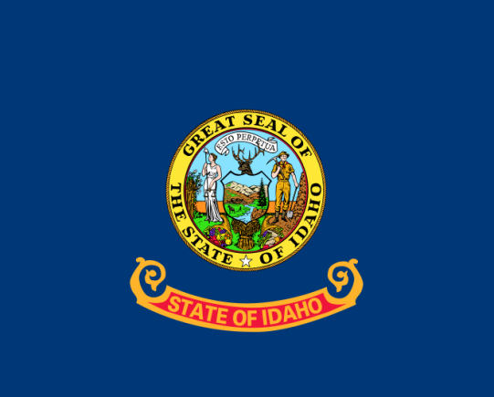
Idaho
The State conducted three regional trainings for law enforcement and community members, including trainings for youth who will participate in shoulder tap operations. Training for alcohol retailers in the region was also offered and well-attended. More than 4,000 retailers received free ID Checking Guides.
Approximately 30,000 copies of Turning 18 in Idaho: A Survival Guide for Teenagers were distributed to youth. This publication was produced, printed, and distributed in partnership with the Idaho Law Foundation, the College of Law at the University of Idaho, and the Idaho Departments of Education and Juvenile Corrections.
Over the past year, 450,000 underage drinking tabloids were distributed with all of the State’s local and weekly newspapers. A critical partner in this effort was Jacksons Food Stores which helped to produce the publication and held monthly online gas card drawings to incentivize people to take an online survey about the publication’s affect on them. Most respondents have indicated they are much more inclined to help prevent teen access to alcohol.

Slide 18
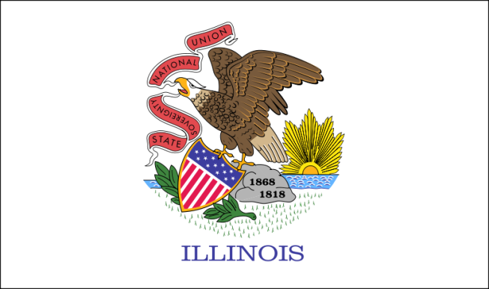
Illinois
The Charleston Police Department increased student underage drinking referrals to the Office of Student Standards at Eastern Illinois University by 274 percent in the first year of the EUDL University Discretionary Grant.
The Lake County Underage Drinking Prevention Task Force, in only one year’s time, worked with 19 municipalities to pass a new social host ordinance and to strengthen an existing ordinance.
The Illinois Supreme Court ruled that a 2008 Illinois law that imposes a 6-month revocation of driving privileges of a minor convicted of unlawful possession or consumption of alcohol was constitutional and provided for safer highways. Since the law took effect, more than 12,000 minors have had their driving privileges suspended or revoked.

Slide 19
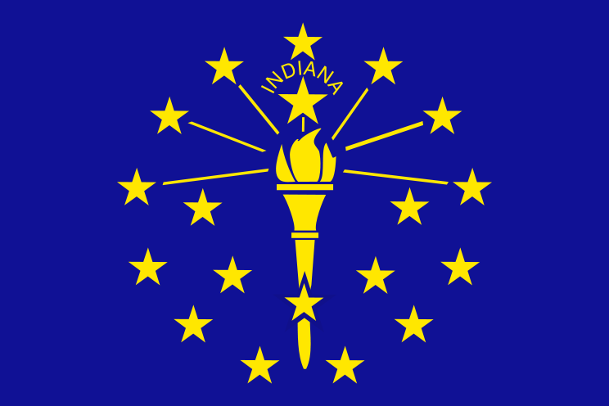
Indiana
The Indiana State Excise Police continues to experience a decline in noncompliance rates. Having conducted 5,587 compliance checks since January 1, 2010, the agency reports a current noncompliance rate of 15 percent. The 2009 noncompliance rate was 29 percent.
On July 1, 2010, Indiana began mandatory ID checks for carryout service.
The Indiana Criminal Justice Institute ran The Choice is Ours campaign from June 25 to July 25, 2010, which included radio spots combined with the Excise Police’s compliance enforcement statewide. The target audience was all Indiana teens, aged 13 to 20. We launched this campaign in the summer months because of the number of social events and activities occurring throughout the season that places teens and young adults (younger than 21) in a high-risk category—hence, they are more likely to give in to negative peer pressure (i.e., to “drink”). The target audience also has much more free, unsupervised time during the summer months, which also makes them more susceptible to engaging in negative and risky behaviors.

Slide 20
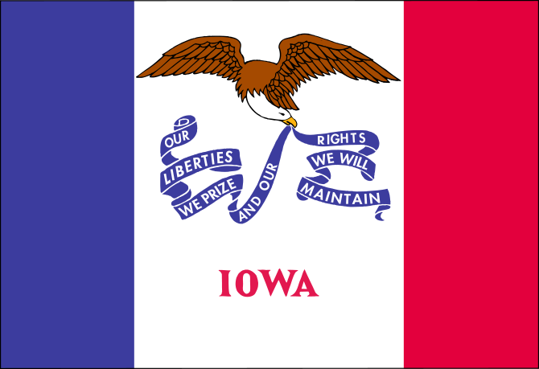
Iowa
Programs of Helping Services of Northeast Iowa have provided training for retail sellers of alcohol. These trainings are provided in person, on DVD, and via the internet. The non-profit agency’s underage drinking prevention public education campaigns target parents, college students, and youth.
Iowa’s Employee & Family Resources (EFR) offers the “ReThinking Drinking” diversion program. The program is centered on restorative justice and requires parental involvement. EFR partners with juvenile and adult court systems to divert young people from traditional criminal prosecution for first offenses. Only 14% of the 5,000 referred persons have been charged again for an alcohol-related violation.
State Patrol EUDL efforts include compliance checks and saturation patrol throughout the state, including during peak party times such as proms, graduations, and community celebrations and events. The agency partner with local county sheriff and municipal police departments and the Governor’s Traffic Safety Bureau to conduct this work.

Slide 21
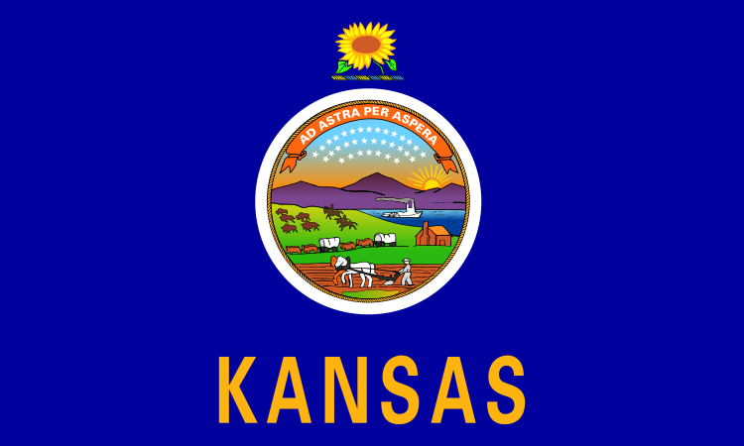
Kansas
A grant to Pottawatomie County Sheriff’s Office enabled additional officers to patrol for underage drinking violations at the County Stampeded Music Festival, a four-day event each June that draws 150,000 people. Last year, 48 minor-in-possession (MIP) and 7 open container citations were issued along with 4 DUI and 2 narcotics arrests.
An annual grant to the Department of Wildlife and Parks enabled extra springtime enforcement of underage drinking laws on State lands. Officers broke up 14 field parties, confiscated 529 containers of alcohol, made 35 MIP arrests, one drug arrest, and 11 consuming-in-public arrests.
The EUDL Lead Agency, the Kansas Department of Transportation, sponsored the Fourth Annual Sobriety Rocks contest in the spring of 2010. Winners in the categories of art, music, original writing, and video received $1,000 scholarships, and their winning pieces will be featured in promotional materials aimed at promoting alcohol-free living among underage youth and posted on the web at www.sobrietyrocks.net.

Slide 22
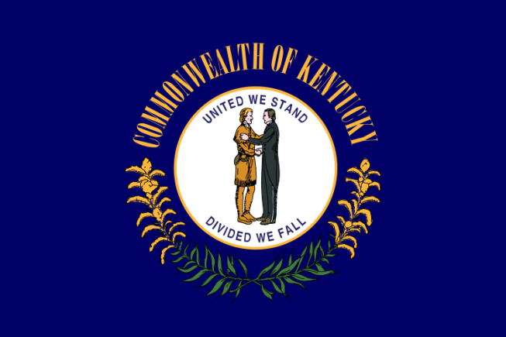
Kentucky
MADD – In 2009, there were 20 active “Youth in Action” teams with 365 active youths who placed 27,660 Sticker Shock labels in 48 retail establishments across the State.
In 2009, the Kentucky Alcohol Beverage Control (ABC) Education Branch held 189 STAR (Server Training in Alcohol Regulation) classes certifying 3,948 people. Ten of those classes were held for Hispanic servers. For those classes, the trainers spoke Spanish, and course materials were provided in Spanish.
In 2009, the Kentucky ABC conducted 2,693 compliance checks, resulting in 205 illegal buys for a statewide compliance rate of 92 percent.
In 2009, the Kentucky ABC conducted 53 targeted enforcement details statewide (festivals, Kentucky Derby, college campus tailgating, etc.), resulting in 623 citations. Eighty percent of those violations were for Minor in Possession of Alcohol.

Slide 23
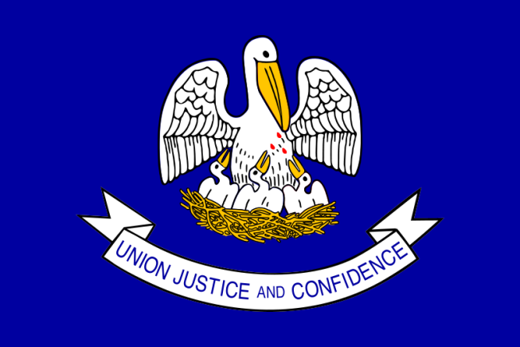
Louisiana
The Louisiana office of Alcohol and Tobacco Control (ATC) increased statewide alcohol compliance from 90 to 92 percent during the past year. ATC conducted more than 8,000 compliance checks statewide during the past year.
Louisiana ATC developed an enhanced compliance check training program, which is available to local law enforcement agencies. ATC trains local law enforcement agencies in proper procedure and protocol for conducting compliance checks. ATC has more than 13 years of practical experience and has conducted more than 85,000 compliance checks within all areas and jurisdictions of the State. Local officials are also trained in proper data collection and data management related to compliance checks.
The Louisiana statewide enforcement effort has continued to offer targeted proactive enforcement of underage alcohol procurement and consumption laws statewide, including large events (such as Mardi Gras) and college and professional sporting events.

Slide 24
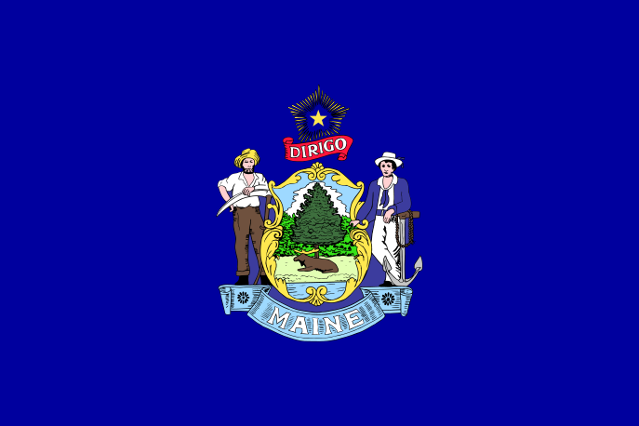
Maine
The on-premise version of Card ME was launched. The Card ME program is a voluntary responsible alcohol sales/service program that aims to reduce sales of alcohol to minors and visibly intoxicated persons. The program provides managers and owners with free tools, materials, and guidance to help set norms among and expectations for employees and facilitate conditions in which service or sales of alcohol remains lawful.
Maine’s Higher Education Alcohol Prevention Partnership created an interactive, online education tool that will be used with college students in the coming year. The tool teaches about the State’s liquor laws and the risks and responsibilities associated with providing alcohol to underage people and with providing a place for adults to consume alcohol.
Maine created a website for alcohol licensees to develop alcohol sales policies. Licensees “click” the items they want in their policy, and the website will create a downloadable policy for them to print and reproduce for their business. The website is located at: www.maineosa.org/prevention/community/licensee.

Slide 25
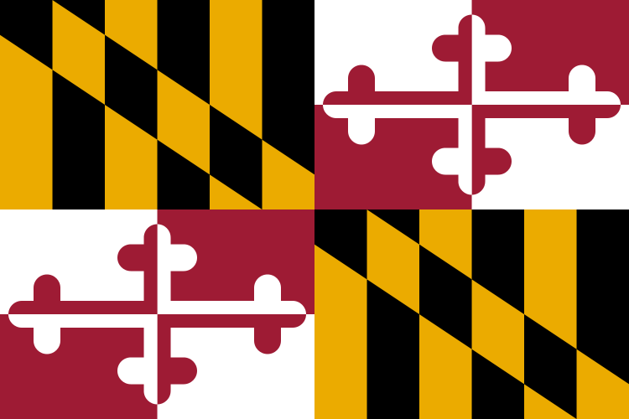
Maryland
From 2008 through 2009, Maryland showed a 41 percent increase in retailers’ compliance, as a result of the Governor’s Office of Crime Control & Prevention awarding EUDL funds to many of Maryland’s jurisdictions.
With EUDL funding from the Governor’s Office of Crime Control & Prevention the Montgomery County Department of Liquor Control “Cops in Shops” program educated about 100 servers with free, State-approved, server training in Spanish. These servers would have otherwise not been trained; they had a very poor understanding of alcohol laws before the training.
The Baltimore County Police Department’s special Underage Drinking Task Force using cyber-intelligence shut down numerous illegal party buses in the Towson University area, reducing alcohol-related traffic citations and injuries.

Slide 26
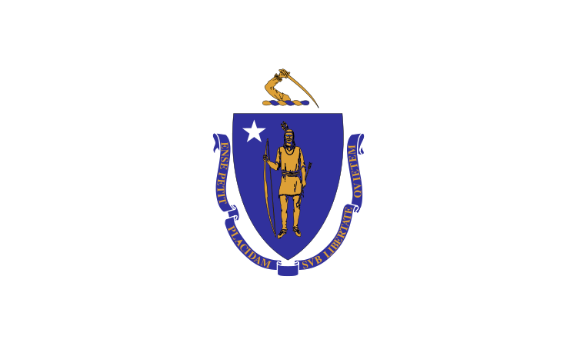
Massachusetts
The Massachusetts Alcoholic Beverages Control Commission, in cooperation with the Youth in Action program, sponsored by Mothers Against Drunk Driving, and several community coalitions worked to conduct compliance check operations. In 2009, 2,044 compliance checks were conducted in 125 municipalities across Massachusetts. Of these, 109 failed producing a 95 percent compliance rate. So far in 2010, 1,317 establishments have been checked and 119 have failed, for a 90 percent compliance rate.
The Berklee College of Music finished its second year of The College/University Alcohol Education Grant Demonstration Project. Berklee continued to build its coalitions, sponsored a substance abuse awareness songwriting competition, hosted several Choose Well events, and started a Brief Alcohol Screening and Intervention for College Students (BASICS) program.

Slide 27
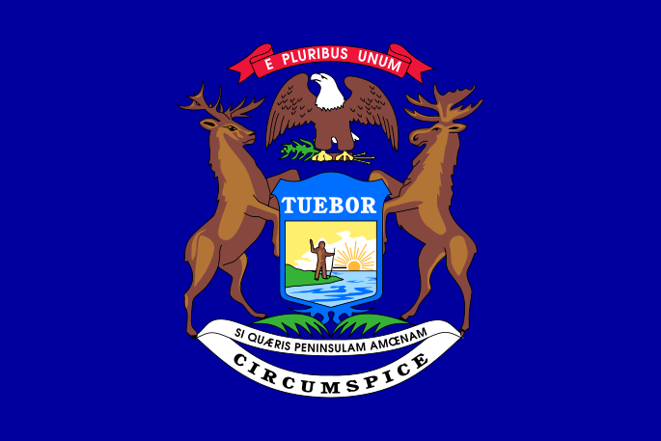
Michigan
Law enforcement agencies in more than 40 counties issued more than 1,700 minor-in-possession citations and conducted 3,660 compliance checks, issuing only 377 violations. The Detroit Police Department conducted more than 600 of those compliance checks, and during one check, officers found and confiscated drug paraphernalia, including 5,000 crack pipes.
The Michigan Coalition to Reduce Underage Drinking (MCRUD) hosted several innovative trainings on topics, including high school athletic policies with John Underwood. MCRUD also held brief alcohol screenings and interventions for college campus staff, as well as media literacy training for youth.
Law enforcement subgrantees will be taking digital investigative classes to gather intelligence on underage drinking activities in their communities. The Detroit Police Department has been using social media Web sites to locate and shut down large underage drinking parties in its jurisdiction, which has sent a strong enforcement message that underage drinking will not be tolerated.

Slide 28
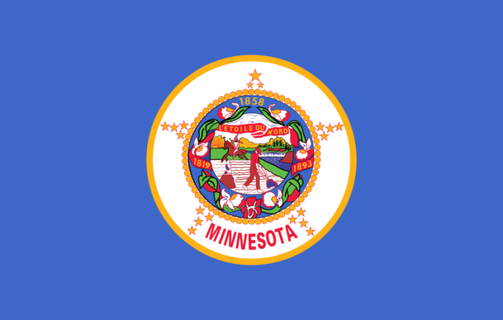
Minnesota
The EUDL Lead Agency funded the Minnesota Institute of Public Health to develop a cinema-based public awareness campaign aimed at 21- to 29-year olds. Messages focused on the dangers and risks of providing alcohol to minors and appeared on 107 screens with an estimated 392,000 viewings.
Social Host ordinances were adopted in 21 additional counties and cities. This brings the total number of local jurisdictions with such ordinances to 47. An additional 15 cities and counties are currently considering an ordinance. There were no Social Host ordinances in effect in the State prior to 2007.
Fourteen law enforcement agencies conducted enhanced underage drinking enforcement activities near seven colleges and universities during periods that often experience increased alcohol-related problems. Each activity included pre- and post-media outreach. Enforcement activities resulted in 25 arrests (including 14 for DWI) and 782 citations; 692 for minor consumption and 14 for social host ordinance violations.

Slide 29
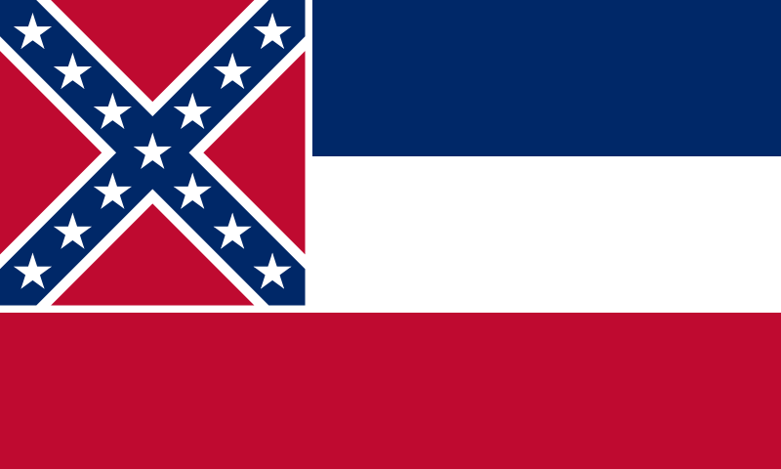
Mississippi
The Alcohol and Tobacco Enforcement Division of the Mississippi Attorney General’s Office conducted 4,702 compliance checks statewide yielding a compliance rate of 89 percent and provided retailer training to 583 clerks.
EUDL funds were used by Mississippi to increase its public awareness efforts by strengthening its media campaign through cinema advertising and increasing college awareness efforts. During a 3-month campaign, more than 136,290 Mississippians were reached weekly as a result of the cinema advertisements.
In addition to working with law enforcement, Mississippi has used its funds to educate its citizens by disseminating information at public awareness events, college athletic events, and at middle schools, junior schools, and high schools throughout the State, reaching more than 1 million Mississippians.
Mississippians Advocating Against Underage Drinking (MAAUD) was the only statewide coalition to apply and be accepted as part of this year’s Leadership Institute. MAAUD’s mission is to develop and sustain initiatives that inform and advocate against underage drinking in Mississippi. MAAUD, in conjunction with numerous local coalitions, conducted two statewide sticker shock operations during the year. MAAUD also continues to work with legislators and communities in hope of passing a social host bill.

Slide 30
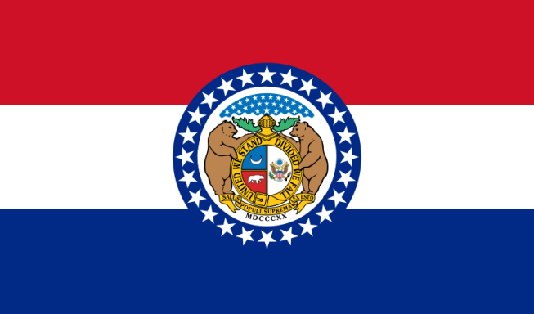
Missouri
The State provided funding to 27 law enforcement agencies to conduct compliance checks of retail liquor establishments, party patrols and controlled party dispersal operations, and special events management.
The State provided funding to the University of Missouri Partners in Prevention program to arrange for and provide training for law enforcement. It also provided funding to the Division of Alcohol and Tobacco Control to provide training to retail merchants and to participate in other local and statewide initiatives.
The State received discretionary funding to work with Whiteman Air Force Base and the surrounding communities to address policy and programs aimed at reducing underage and hazardous drinking among young air men.

Slide 31
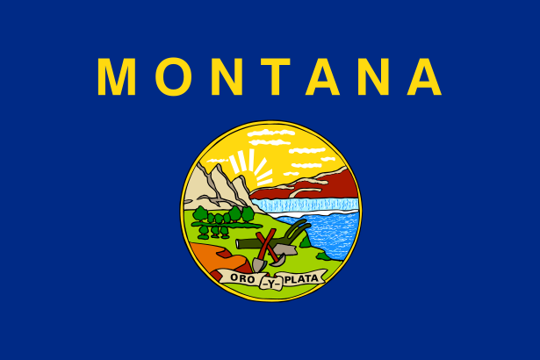
Montana
The Great Falls Social Host Ordinance passed in September 2009. Great Falls received a EUDL Military Discretion grant that concluded at the end of September, and the passage of the ordinance represented the achievement of a core grant requirement: implementation of a significant policy change that would facilitate reductions of alcohol available to underage persons.
As part of an effort to strengthen the penalties for selling alcohol to minors and intoxicated persons, the Alcohol Control Division of the Department of Revenue scheduled a hearing to receive public comment on this matter. The Common Sense Coalitions has prepared to advocate such modifications.
Law enforcement officers from across the State received training from the Underage Drinking Enforcement Training Center on how to conduct compliance checks and implement controlled party disbursal techniques. Officers from tribal enforcement agencies were included among those who received training.

Slide 32
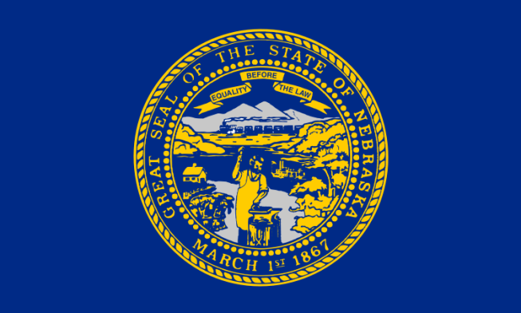
Nebraska
The State adopted a “Use & Lose” law. The law mandates driver’s license revocation for minors under the age of 19 who are convicted of violating the State’s alcohol consumption and/or possession laws.
Alcohol-related injury and fatal crashes involving drivers aged 20 and younger declined by 25% last year and reached a 20-year low for both alcohol-related fatal and injury crashes.
The State enhanced media marketing of the Reporting Underage Drinking Tip Line (1-866-MUST-BE-21) with donated talent for radio/television/print ads by Nebraska native Dan Whitney (aka Larry the Cable Guy).

Slide 33
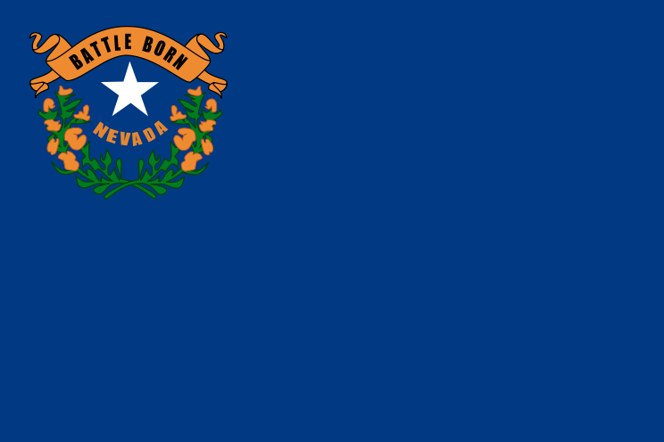
Nevada
The Nevada Department of Taxation has implemented the Responsible Beverage Server Training law, requiring that 50 percent of revenue from the fines collected be placed in the Nevada statewide EUDL budget. The fines against the business are $500, $1,000, and $5,000 for a first, second, and third offense, respectively, occurring within 24 months. More than $7,000 in fines was collected within the first several months from only one department.
The success of the Rural Discretionary Grant in Lyon County continues beyond the end period of 2008. The local county commissioners have adopted a graduated sanctions policy related to citations issued for sales to minors and also have mandatory server training.
For the 10th consecutive year, alcohol-related risk behaviors among high school students in Nevada continue to decline according to the 2009 Nevada Youth Risk Behavior Survey.

Slide 34
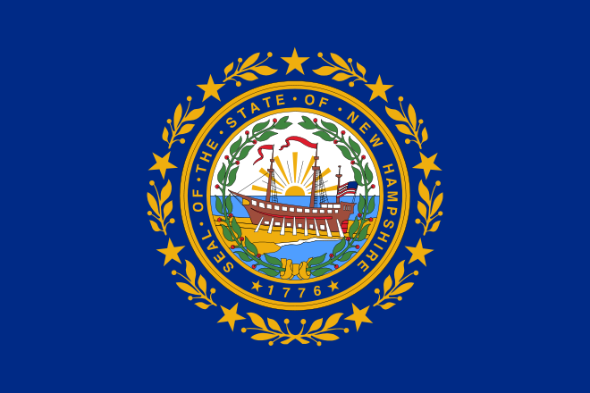
New Hampshire
The State is creating a centralized database for false identification cards (IDs) using a scanner that can detect and document any alterations made to an ID. The scanner is portable and will be used statewide.
The Strafford County Sheriff’s Department along with 25 other law enforcement agencies participated in the making of a training video on controlled party dispersal operations. The video and the detailed protocols developed by the Sheriff’s Department are available to law enforcement agencies throughout the state.
The Community Alliance for Teen Safety, the Derry Police Department, and the EUDL Lead Agency produced a 60-second public service announcement (PSA) that chronicles the path of a teen who drank before prom and later was a driver in a fatal motor vehicle accident. The PSA aired at local movie theaters during prom season.

Slide 35
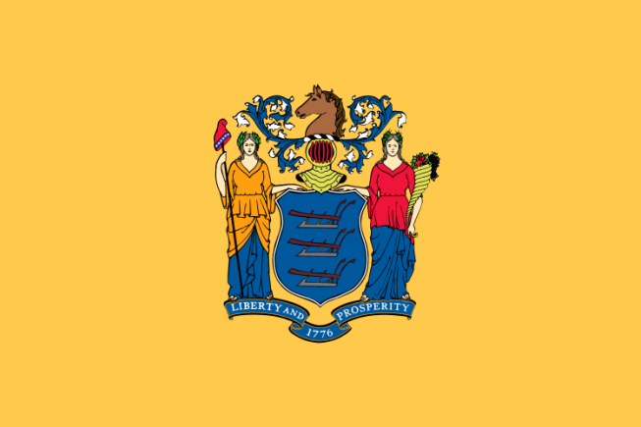
New Jersey
Through a EUDL sub-grant, Fatal Vision programs were facilitated at middle school and high schools in northern New Jersey. These programs reached 3,226 students at 18 schools. A program for parents about the danger of underage drinking was also offered at these schools.
A Proms and Alcohol Don’t Mix television public service announcement (PSA) contest was held for high school seniors throughout the State. Students created and starred in the PSAs. The winners and runners-up were treated to a celebration at the Governor’s residence. The winning PSAs were aired on cable television stations during prom season.
The Division of Alcoholic Beverage Control awarded 24 sub-grants to law enforcement agencies across the State. These grants cover officer overtime for underage drinking law enforcement activities.

Slide 36
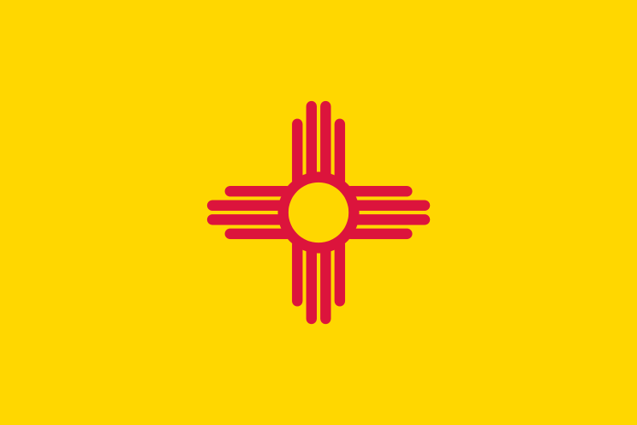
New Mexico
EUDL subcontractor Sandoval County is implementing cohorts of the “Dare to be You” curriculum in our Native American Pueblos. The “Dare to be You” curriculum focuses on positive youth development and prevention of problem behaviors for parents and children. Parents and children receive separate curricula on the same topic, and at the end of each session, parents and children come together and practice what they have learned. Each family receives 12 weeks of education; then, a graduation is held where the Governor of the Pueblo presents them with certificates. It is a wonderful program with excellent results.
The New Mexico MADD subcontractor, since taking over as “Youth in Action” coordinator, has made a significant impact in helping to prevent underage drinking with operations that covered 200 bars, restaurants, and supermarkets. Two years ago, the compliance rate was 60 percent; today, with the help of the Albuquerque Police Department (also a EUDL subcontractor) and the diligence of the “Youth in Action” team, it is 95 percent.

Slide 37
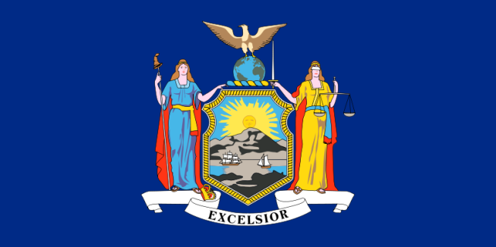
New York
The State has provided 13 Party Patrol and Controlled Party Dispersal trainings since 2006. More than 1,000 law enforcement and prevention professionals have been trained during the sessions, and they have later implemented the techniques they learned.
The State released a new video, Underage Drinking Prevention: Taking Action in New York. The video highlights the underage drinking prevention efforts in the State; many of which were made possible through EUDL funding. It also issues a call to action eliciting involvement from prevention providers, law enforcement personnel, members of the judiciary, colleges, and community coalitions.
For the past two years, the State has provided funding to enable 27 prevention providers to partner with law enforcement to develop and implement underage drinking enforcement operations, beverage server training, and youth leadership development initiatives.

Slide 38
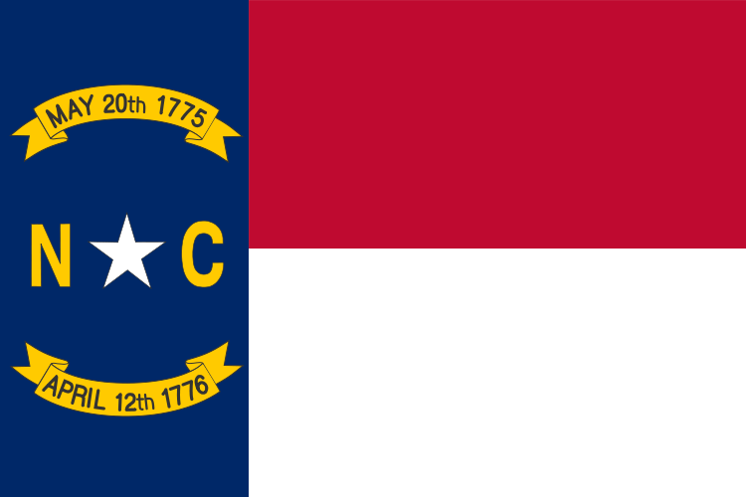
North Carolina
In the spring of 2010, the Raleigh City Council approved a plan to name the State capital’s new Amphitheater after the product Bud Light in exchange for approximately $1.5 million over 5 years. Advocates to prevent underage drinking, led by retired Superior Court Judge Ron Bogle, launched a successful statewide effort to halt the proposed exception to North Carolina law. In rejecting the Raleigh City Council’s petition, Chairman Jon Williams of the North Carolina Alcohol Beverage Control (ABC) Commission cited “overwhelming” opposition to the petition from across the State and the Nation. The ABC Commission’s vote was unanimous.
Since the Charlotte-Mecklenburg Drug Free Coalition began conducting alcohol purchase surveys in 2006, there has been an 83 percent reduction in the number of supermarkets that sold alcohol to a youthful-looking buyer. In 2006, 29 percent of supermarkets sold to the youthful-looking buyer, and in 2009, that number was lower than 5 percent. A significant decrease has also been seen in the number of drug stores that sold alcohol to youth. From a high in October of 2008 of 36 percent, the number of drug stores that sold alcohol to youthful-looking buyers was down by 72 percent in October of 2009 (10%). Overall, the alcohol purchase survey sales rate in Charlotte-Mecklenburg has decreased over the past 3 years by 24 percent.

Slide 39
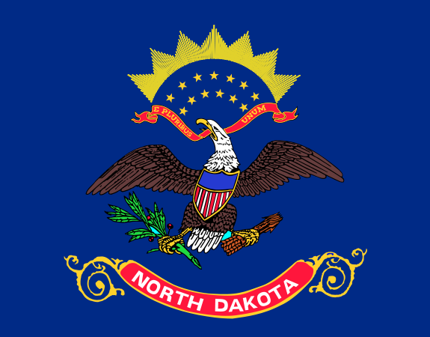
North Dakota
The State completed a Community Readiness/Needs Assessment Survey in three tribal regions. All three Tribal Councils have approved use of the data to develop data-driven strategic planning and initiate action in the tribal communities.
A multi-agency conference for school/community members resulted in 20 communities developing action plans to address underage drinking.
With funding from the State, Prairie Public Broadcasting developed and launched the High Risk High website (highriskhigh.org) focusing on youth drinking in North Dakota. The website is designed to provide information to students, teachers, parents, and community members.

Slide 40
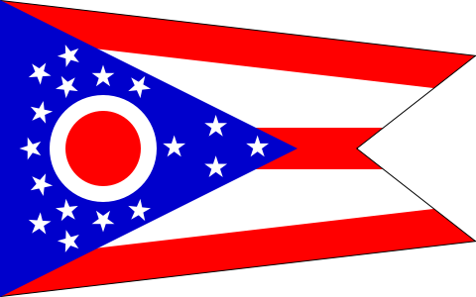
Ohio
In 2010, local law enforcement agencies conducted 537 compliance checks and 30 party patrols involving a total of 815.75 law enforcement hours. Without EUDL funding, it is unlikely that such law enforcement activity could have taken place.
The State hosted The Life of an Athlete, a training that highlights the importance of an alcohol-free lifestyle for student athletes. Conducted by the American Athletic Institute, more than 100 participants attended, including athletic directors, coaches, AOD prevention professionals and student athletes. The coach of The Ohio State University football team, Jim Tressel, joined the training to underscore the message’s importance.
A Public Service Announcement (PSA) on the topic of “blind hosting” (or unsupervised teen parties) was created. The key message delivered is that being absent from the party is still being a party to teenage drinking. The DVD version of the PSA has been viewed by more than 500 people.

Slide 41
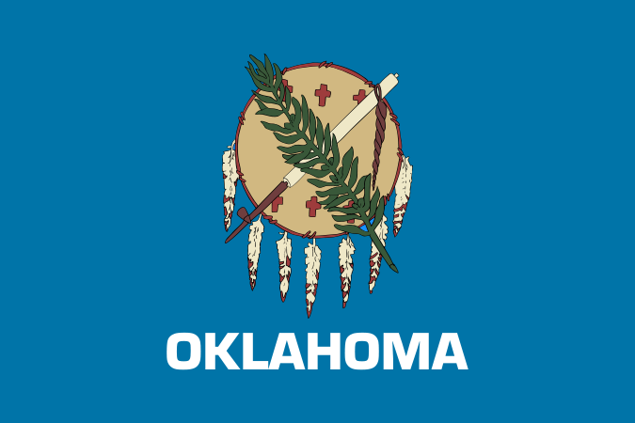
Oklahoma
The first Oklahoma 2M2L (Too Much To Lose) Youth Council convened in February 2010. The 2M2L Council began the 2M2L Academy in which youth are offered various training opportunities through regional retreats and webinars. Additionally, the number of law enforcement 2M2L trainings since last year have more than doubled, with more than 200 officers from around the State participating.
The State hosted 63 Town Hall Meetings in March and April. The meetings focused on underage drinking prevention at the community level.
Oklahoma hosted Reality Parties in 18 communities on November 18th. These parties involved teens performing as underage drinkers at teen drinking parties while an audience of parents and media toured the scripted event. Reality Parties drew more than 860 adults and concluded with the provision of information about the importance of passing and/or enforcing Social Host ordinances. Oklahoma now has 86 Social Host ordinances.

Slide 42
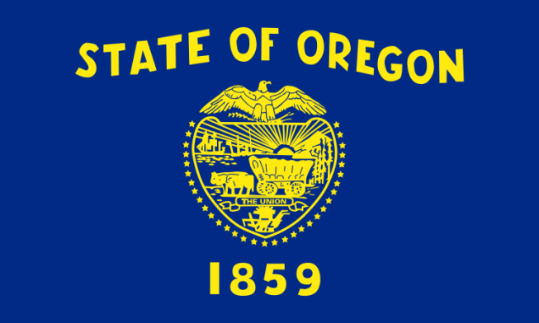
Oregon
After steady increases since the year 2000, Oregon’s 30-day alcohol use rates posted a drop in rates at the 8th and 11th grade levels for the second year in a row.
Oregon’s nine Federally-recognized tribes are developing a video to highlight their traditional alcohol and other drug-free youth activities.
The Oregon Partnership and Department of Human Services’ Face It Parents media-based public awareness campaign expanded as a result its new partnership with the Oregon Liquor Control Commission. Additional prevention messages focus on furnishing alcohol to minors and the implementation of shoulder tap enforcement operations.

Slide 43
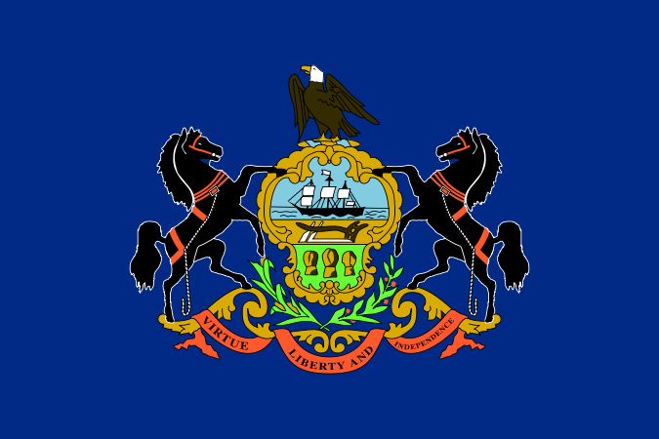
Pennsylvania
2009 celebrated the 7th Annual Youth Advocacy day at the State capitol sponsored by the Pennsylvania SADD group. As of this year, more than 2,000 youth have come together to meet with their respective legislators and discuss policy solutions for addressing underage drinking issues.
The State College Borough Police Department and the Penn State University Police Department have partnered on 119 details and made 335 arrests. In addition to these enforcement efforts, in 2009 the Pennsylvania State Police, Bureau of Liquor Control Enforcement, were assisted by 65 youths to conduct compliance checks in 792 licensed establishments.
Over the past year, the Pennsylvania Liquor Board’s Bureau of Alcohol Education coordinated 23 trainings for more than 400 law enforcement officers and hosted an annual statewide conference for more than 230 multidisciplinary professionals and students. In addition to the training efforts, the Liquor Board conducted 8 statewide youth focus groups with 76 participants. This information resulted in 2 meetings in Harrisburg with 30 youth participants to discuss ongoing strategies to prevent underage drinking in Pennsylvania.

Slide 44
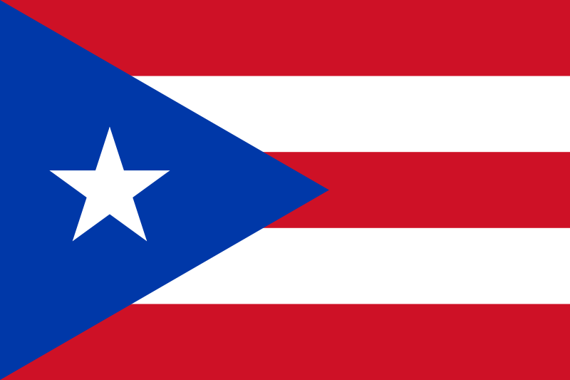
Puerto Rico
The EUDL Lead Agency in Puerto Rico, Office of the Commissioner of Municipality Affairs (OCMA) established administrative processes for implementing the grant, and ensuring coordination with partnership agencies. The Puerto Rico EUDL program implemented three Grant components.
The Class Action curriculum (the high school-based version of Project Northland, an evidence-based alcohol prevention curriculum) is based on the social-influences model for alcohol prevention. The program emphasizes the social and legal consequences of alcohol use and works toward meetings of high school students to increase their awareness of the social availability and the social consequences of alcohol. In Puerto Rico, 24 high schools (95 percent of 1,205 students) were made aware of the legal issues surrounding underage alcohol use. Recognized underage alcohol use as a communitywide problem was discussed, and the legal intricacies of alcohol and related issues were debated. Students learned about the social, emotional, economic, and legal consequences of underage alcohol use.
A community-based program for youths and families (500 families).
A media campaign was conducted to emphasize healthy living by youth; a phone number was provided for reporting businesses that sell alcohol to minors. “Somos + los que jangueamos sin alcohol” (which means, “There are more of us that hang out without alcohol.”). Youth are making a difference in underage drinking prevention in Puerto Rico. In 2007, 70.3 percent of the 12- to 15-year-olds did not use alcohol. These teens can become a powerful tool in the community’s underage drinking prevention efforts. As role models, advocates, and adverts, youth are in unique position to help organizations reach other adolescents who are at risk or who are already using alcohol.

Slide 45
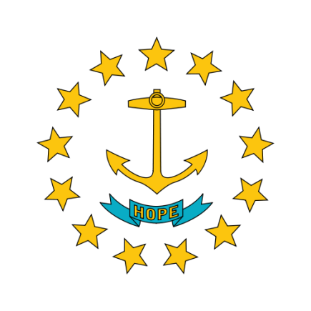
Rhode Island
EUDL funds provide Tiverton, Rhode Island—a rural community—with an opportunity to level the prevention playing field. It has provided access to training and capacity-building opportunities for community coalition members and community volunteers. Further, in this era of accountability and sustainability, it gives the Tiverton Prevention Coalition the tools it needs to ensure continued prevention efforts into the future.
Rhode Island’s procurement statute now contains language that holds 18- to 21-year-olds accountable for providing alcohol to other minors.
Law enforcement partnered with young people to create statewide underage drinking prevention messages that were highlighted on billboards and community vehicle message boards.

Slide 46
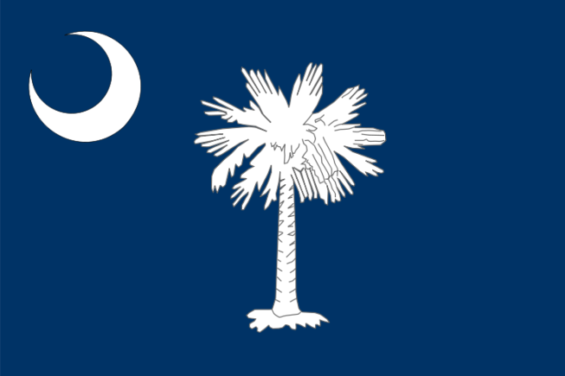
South Carolina
Out of Their Hands (the State’s first ever high-visibility enforcement blitz focused on prom and spring break seasons) was a phenomenal success with no deaths resulting from the 11-day blitz periods. The operations resulted in 871 compliance checks (both on- and off- premise), 71 public safety checkpoints, 95 shoulder tap operations, and 32 party dispersals. Regional press conferences, law enforcement “ride alongs” and other media events were held in conjunction with the campaign.
The State received funding from the National Highway Traffic Safety Administration to produce a 19-minute DVD on the use of checkpoints and underage drinking. The DVD was given to law enforcement officers and agencies throughout the State.
The EUDL Lead Agency and four colleges and universities received an OJJDP discretionary grant to implement community environmental strategies n the four campus communities.

Slide 47
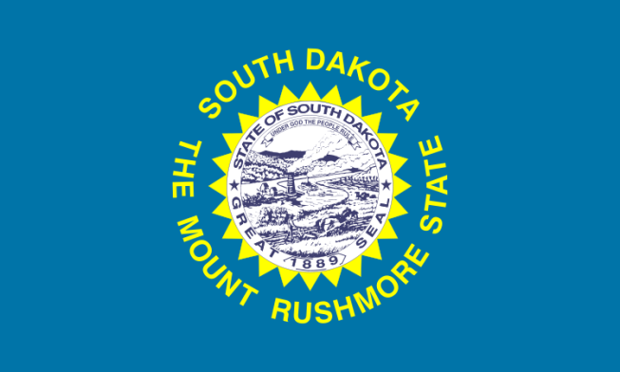
South Dakota
Volunteers of America is working closely with college groups statewide to bring education and enforcement efforts together. At South Dakota State University, for example, student counseling and wellness centers are now playing an integral role in following campus security interaction with underage offenders.
South Dakota Teen Court reports that less than 15 percent of youth who completed the program on substance-related offenses reoffended in any way within 6 months of their teen court sentence.
The South Dakota Alcohol Task Force (Davison, Miner, and Aurora Counties) is successfully reducing underage consumption citations. That activity is down 18 percent so far this year. Compliance checks at beverage providers in the task force area are also up on average by more than 22 percent per county.

Slide 48
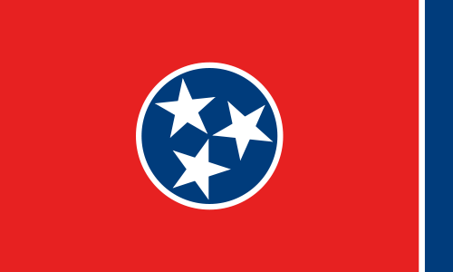
Tennessee
The Community Anti-Drug Coalition of Jackson County works with the Jackson County Sheriff’s Department, the Beer Board, and the General Sessions Judge to establish policies to increase compliance with underage drinking laws. The compliance checks passing rate has reversed itself, from more than three-fourths of the vendors failing to more than three-fourths of the vendors passing compliance checks. Vendors’ awareness of the laws, both compliance checks and followup reviews by law enforcement officers, has increased.
The Brownsville Police Department has increased compliance checks and is educating retail stores and the public on laws and consequences of selling or purchasing alcohol for minors. There is a 92 percent success rate in compliance checks, and the Beer Board’s fines will support the program in the future.

Slide 49
Texas
The State revamped the EUDL subgrantee process to encourage and facilitate more local law enforcement agencies’ participation.
The Texas Alcoholic Beverage Commission hosted a training of trainers for its commissioned peace officers. These officers will now train other local law enforcement officers on compliance check operations, detection of false identification, operations to address third-party alcohol sales, and controlled party dispersal operations. Trainings will be offered free of charge throughout the State to agencies that request it through the 2young2drink.com Web site.
Texas produced and created three Public Service Announcements (PSAs) formatted for radio and television. These PSAs are available free of charge to organizations in Texas. PSA topics included information to parents and others about providing alcohol to minors, information to minors about the consequences of underage drinking, and information to retailers and community members about the importance of not selling to anyone younger than 21 with an emphasize on military personnel. These PSAs are available for viewing on the www.2young2drink.com Web site and copies may be ordered at education@tabc.state.tx.us

Slide 50
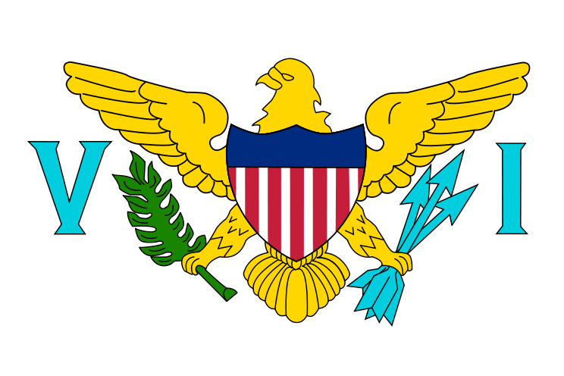
US Virgin Islands
The Virgin Islands has a Teen Summit in May 2010 that will focus, among other topics, on underage drinking.
The Virgin Islands had its first UDETC training and technical assistance in March, including an experiential compliance check exercise.
A EUDL subgrantee held a strengthening families program for the faith community that included a focus on underage drinking.

Slide 51
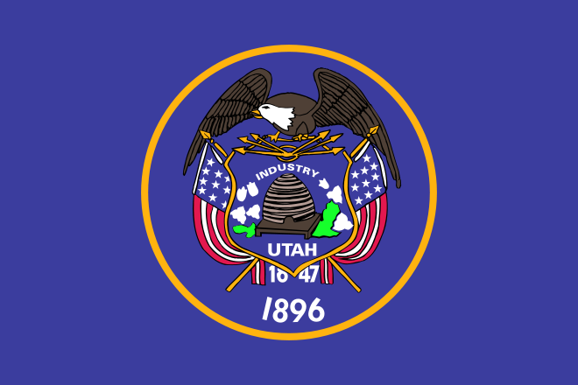
Utah
Underage drinking in Utah saw its most dramatic drop – across all age groups and usage segments – since the Student Health and Risk Prevention (SHARP) survey began. Decreases were recording in underage binge drinking, past 30-day alcohol consumption, and teen lifetime alcohol use, despite the fact that Utah’s underage drinking statistics are only half of the national average.
The State continued to operate its Eliminate Alcohol Sales to Youth (EASY) alcohol compliance check program. This program is believed to have helped contribute to the reductions in underage drinking recorded by the state’s SHARP survey.
The State’s nationally recognized media and education campaign, Parents Empowered, continued to reach parents across the state. This program is believed to have helped contribute to the reductions in underage drinking recorded by the state’s SHARP survey.

Slide 52
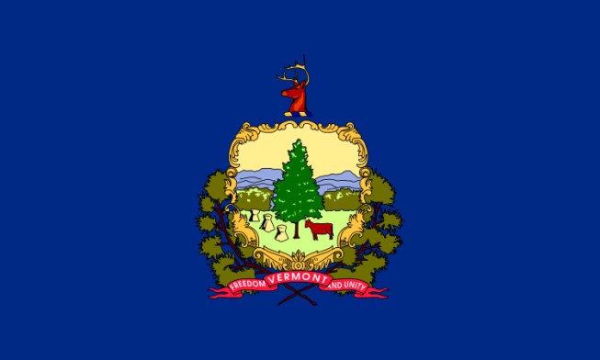
Vermont
The EUDL Advisory Council is now a subcommittee of the Advisory Council for Vermont’s Strategic Prevention Framework State Incentive Grant (SPF-SIG) from SAMHSA. Bringing law enforcement into the planning, implementation and sustainability process has helped further integrate the EUDL work and make our work even more effective.
Using a combination of EUDL and SPF-SIG funds, the State launched the ParentUp, a media campaign encouraging parents to talk to their children about underage drinking.
After many years of inactivity, Vermont’s largest county, Chittenden, is now actively participating in the EUDL program. This spring, patrols were scheduled for every prom and graduation in the county.

Slide 53
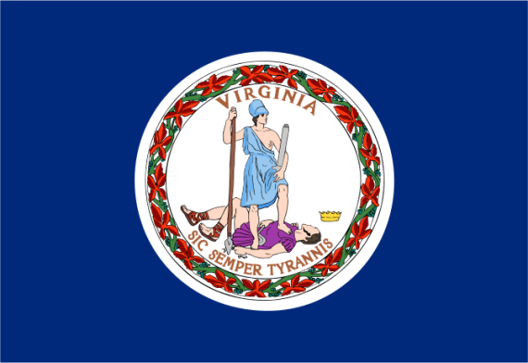
Virginia
The Virginia Department of Alcoholic Beverage Control (VA ABC) awarded a grant to the Prevention Council of Roanoke County to implement an underage drinking prevention banner contest with and a public service announcement (PSA) contest. The PSA contest drew 30 entries from 10 different schools and 1,584 website votes. The Prevention Council selected 36 PSAs for release.
VA ABC also hosted the Youth Alcohol Drug And Prevention Project (YADAPP) 2010, a week-long summer leadership conference for high school students with the motivation and resources to assume positive peer leadership roles within their schools and communities.
VA ABC awarded funding to colleges and universities to participate in Operation Undergrad, an initiative to reduce underage drinking through enforcement and other activities. VA ABC awarded mini-grants to community coalitions to support zero tolerance work.

Slide 54
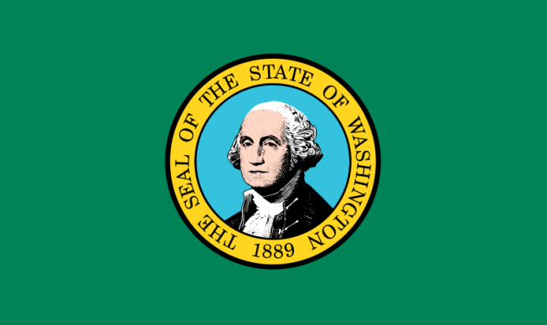
Washington
The Washington State Liquor Control Board adopted new rules after listening to concerned citizens regarding the impact of alcohol marketing on youth. Alcohol retailers are now limited to four alcohol ads on the outside of their businesses! Each sign can be no larger than 1,600 square inches.
The State increased its tax on beer. This important legislative change resulted from coalition members throughout the state becoming vocal, provided background data and information about the issue, and making clear the positive effect a price increase would have on underage drinking.
81 Town Hall Meetings were held in the spring of 2010. These meetings have served to raise awareness and generate support for underage drinking prevention efforts throughout the State.

Slide 55
West Virginia
From December 2009 through May 2010, the West Virginia Underage Drinking Prevention and Social Marketing Project’s public service announcement aired more than 550 times across the state on the CW television network, America’s fifth largest broadcast network.
Twice a month for seven months, advertisements on the dangers and consequences of underage drinking were placed in the West Virginia University’s Daily Athenaeum, a student run newspaper with a circulation of 15,000 students and community members.
For the past 10 years, the West Virginia Combating Underage Drinking Walking Team has participated in the March of Dimes event. This year the team won the award for the largest team with over 50 walkers. In addition to supporting a worthy cause, such outreach serves to increase awareness of underage drinking among a wider audience.

Slide 56
Wisconsin
The Wisconsin Compliance Check Program (FY2009) continues to show that 78 percent of its establishments were in compliance with State and Municipal Underage Drinking Laws. Wisconsin Law enforcement officers made 30,911 underage contacts.
Wisconsin is serious! No Underage Drinking Allowed!! In 2009, 7,443 citations were issued for underage drinking. Wisconsin continues to partner with other State agencies and local communities to implement the “Parents That Host Lose the Most” program. Community coalitions and law enforcement agencies are working together to reduce underage drinking in Wisconsin.
“Hats Off” to all Wisconsin counties, State and local partners, community coalitions, universities, and technical colleges. We are all in the battle together: Combat Underage Drinking in Wisconsin.

Slide 57
Wyoming
A zero-tolerance policy was adopted and enforced by law enforcement departments statewide.
Policymaker Forums showcased the work of law enforcement, prevention professionals, and community leaders in every county.
Collaboration between law enforcement and the F.E.Warren Air Force Base was enhanced that includes using Airmen for compliance checks and retailer training.

